Slide 1

CONNECTTEL CUSTOMER CHURN PREDICTION
Presented by James Ehiabhi

Slide 2

PROBLEM OVERVIEW
ConnectTel Telecom Company faces the pressing need to address customer churn, which poses a significant threat to its business sustainability and growth.
The company's current customer retention strategies lack precision and effectiveness, resulting in the loss of valuable customers to competitors.
To overcome this challenge, ConnectTel aims to develop a robust customer churn prediction system for which you have been contacted to handle as a Data Scientist By leveraging advanced analytics and machine learning techniques on available customer data, the company seeks to accurately forecast customer churn and implement targeted retention initiatives.
This proactive approach will enable ConnectTel to reduce customer attrition, enhance customer loyalty, and maintain a competitive edge in the highly dynamic and competitive telecommunications industry.

Slide 3

OBJECTIVE
The objective is to build a predictive model that identifies customers at risk of leaving so that ConnectTel can take proactive measures to retain them.
How the Company Will Benefit from my solution:
Proactive Retention: By predicting which customers are likely to churn, ConnectTel can implement targeted retention strategies.
Cost Efficiency: Reducing churn can lower the cost associated with acquiring new customers and enhance revenue stability.
Enhanced Customer Experience: Tailored interventions based on predictive insights can improve customer satisfaction and loyalty.
Competitive Edge: Effective churn management can strengthen ConnectTel’s competitive position in the telecom market.

Slide 4

PROJECT GUIDE
Import Relevant Python Libraries.
Data Loading, Cleaning, and Preparation.
Final Cleaned Data for EDA.
Exploratory Data Analysis (EDA).
Feature Engineering.
Model selection, training, and validation.
Model Evaluation.

Slide 5
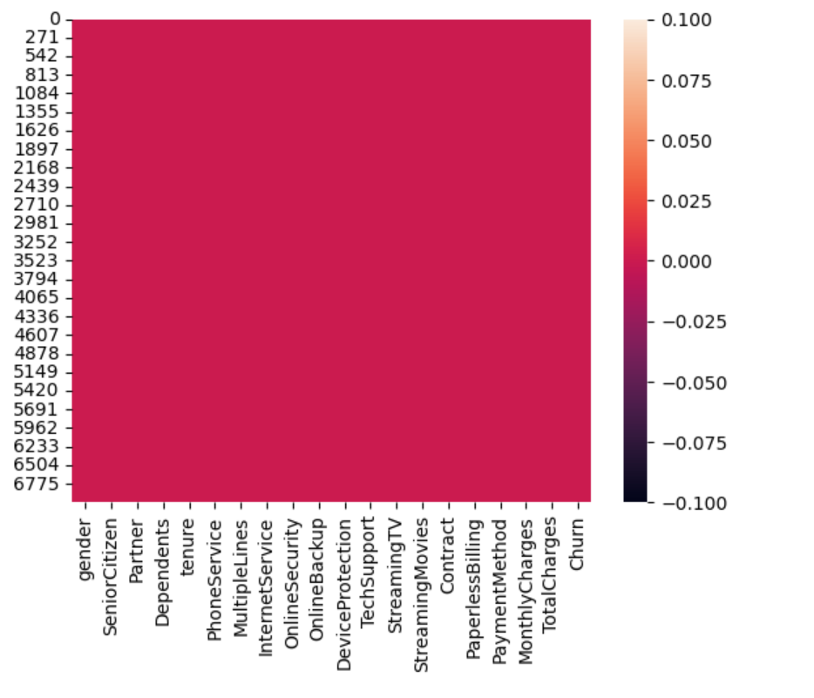
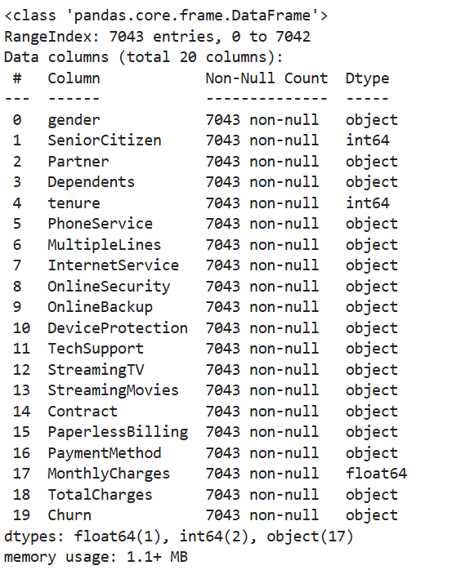
DATA CLEANING FOR EDA
Data verfication - Data type, number of features and rows, missing data 1. Dropped irrelevant column like Customer ID. growth.
2. Replace the missing values in the TotalCharges column with the mean of the existing values.
2

Slide 6
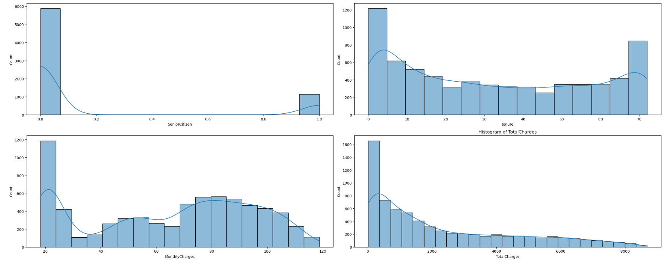
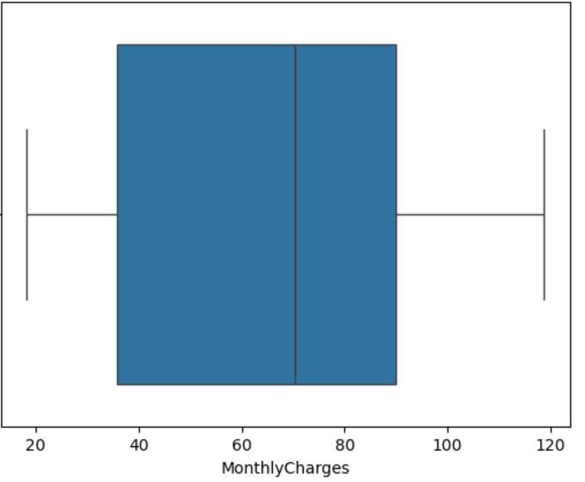
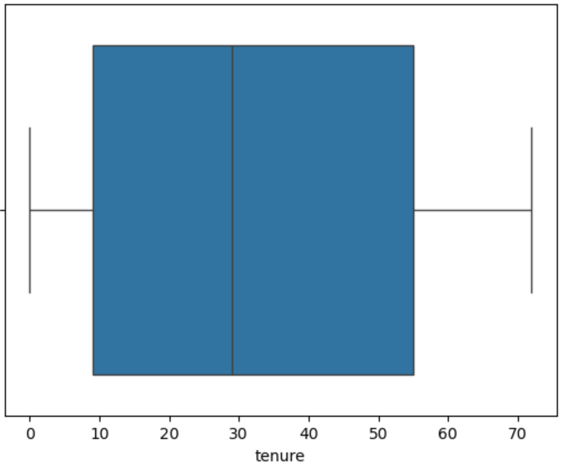
* Numerical Features
Exploratory Data Analysis (EDA)
 | MonthlyCharge | Tenure
Mean | 64 | 32
N-25% | 35 | 9
N-75% | 90 | 55
2

Slide 7
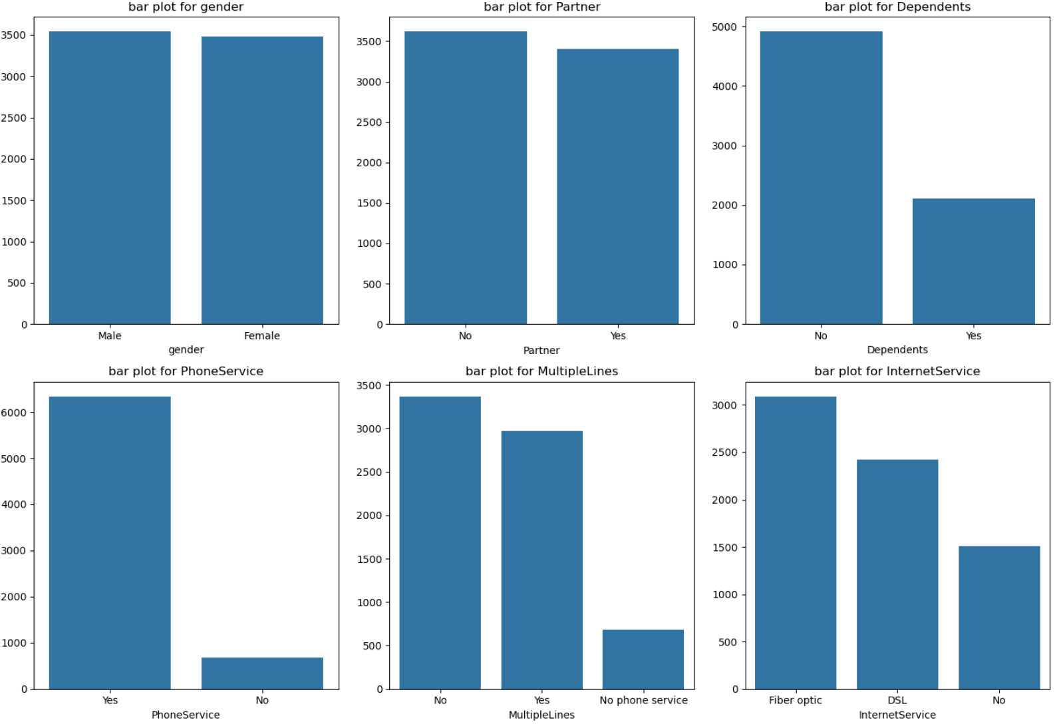
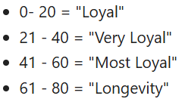
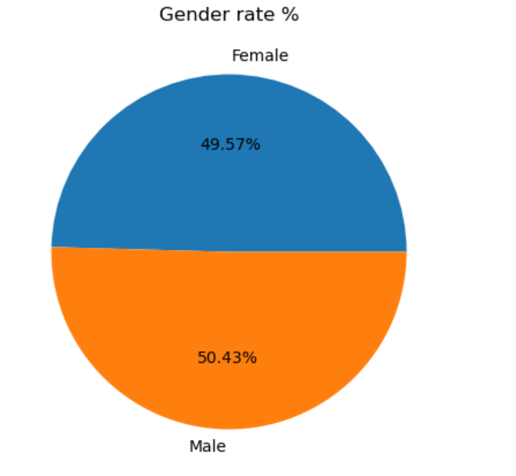
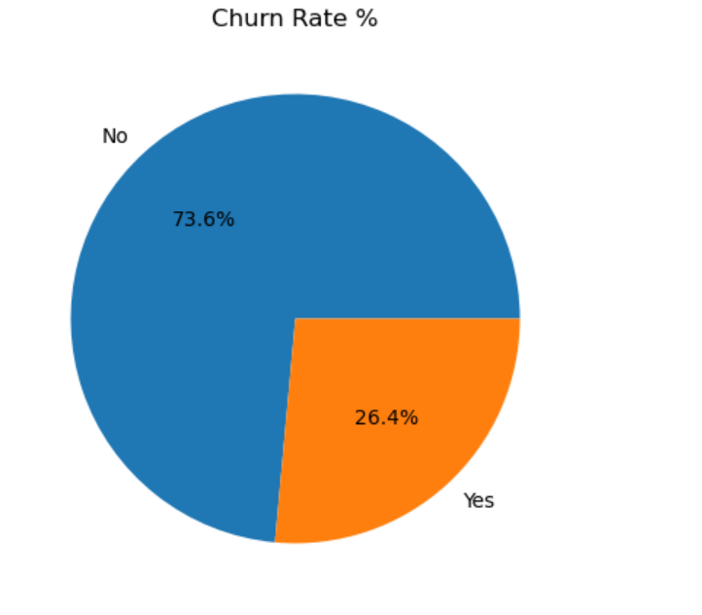
* Numerical Features
Exploratory Data Analysis (EDA)
2

Slide 8
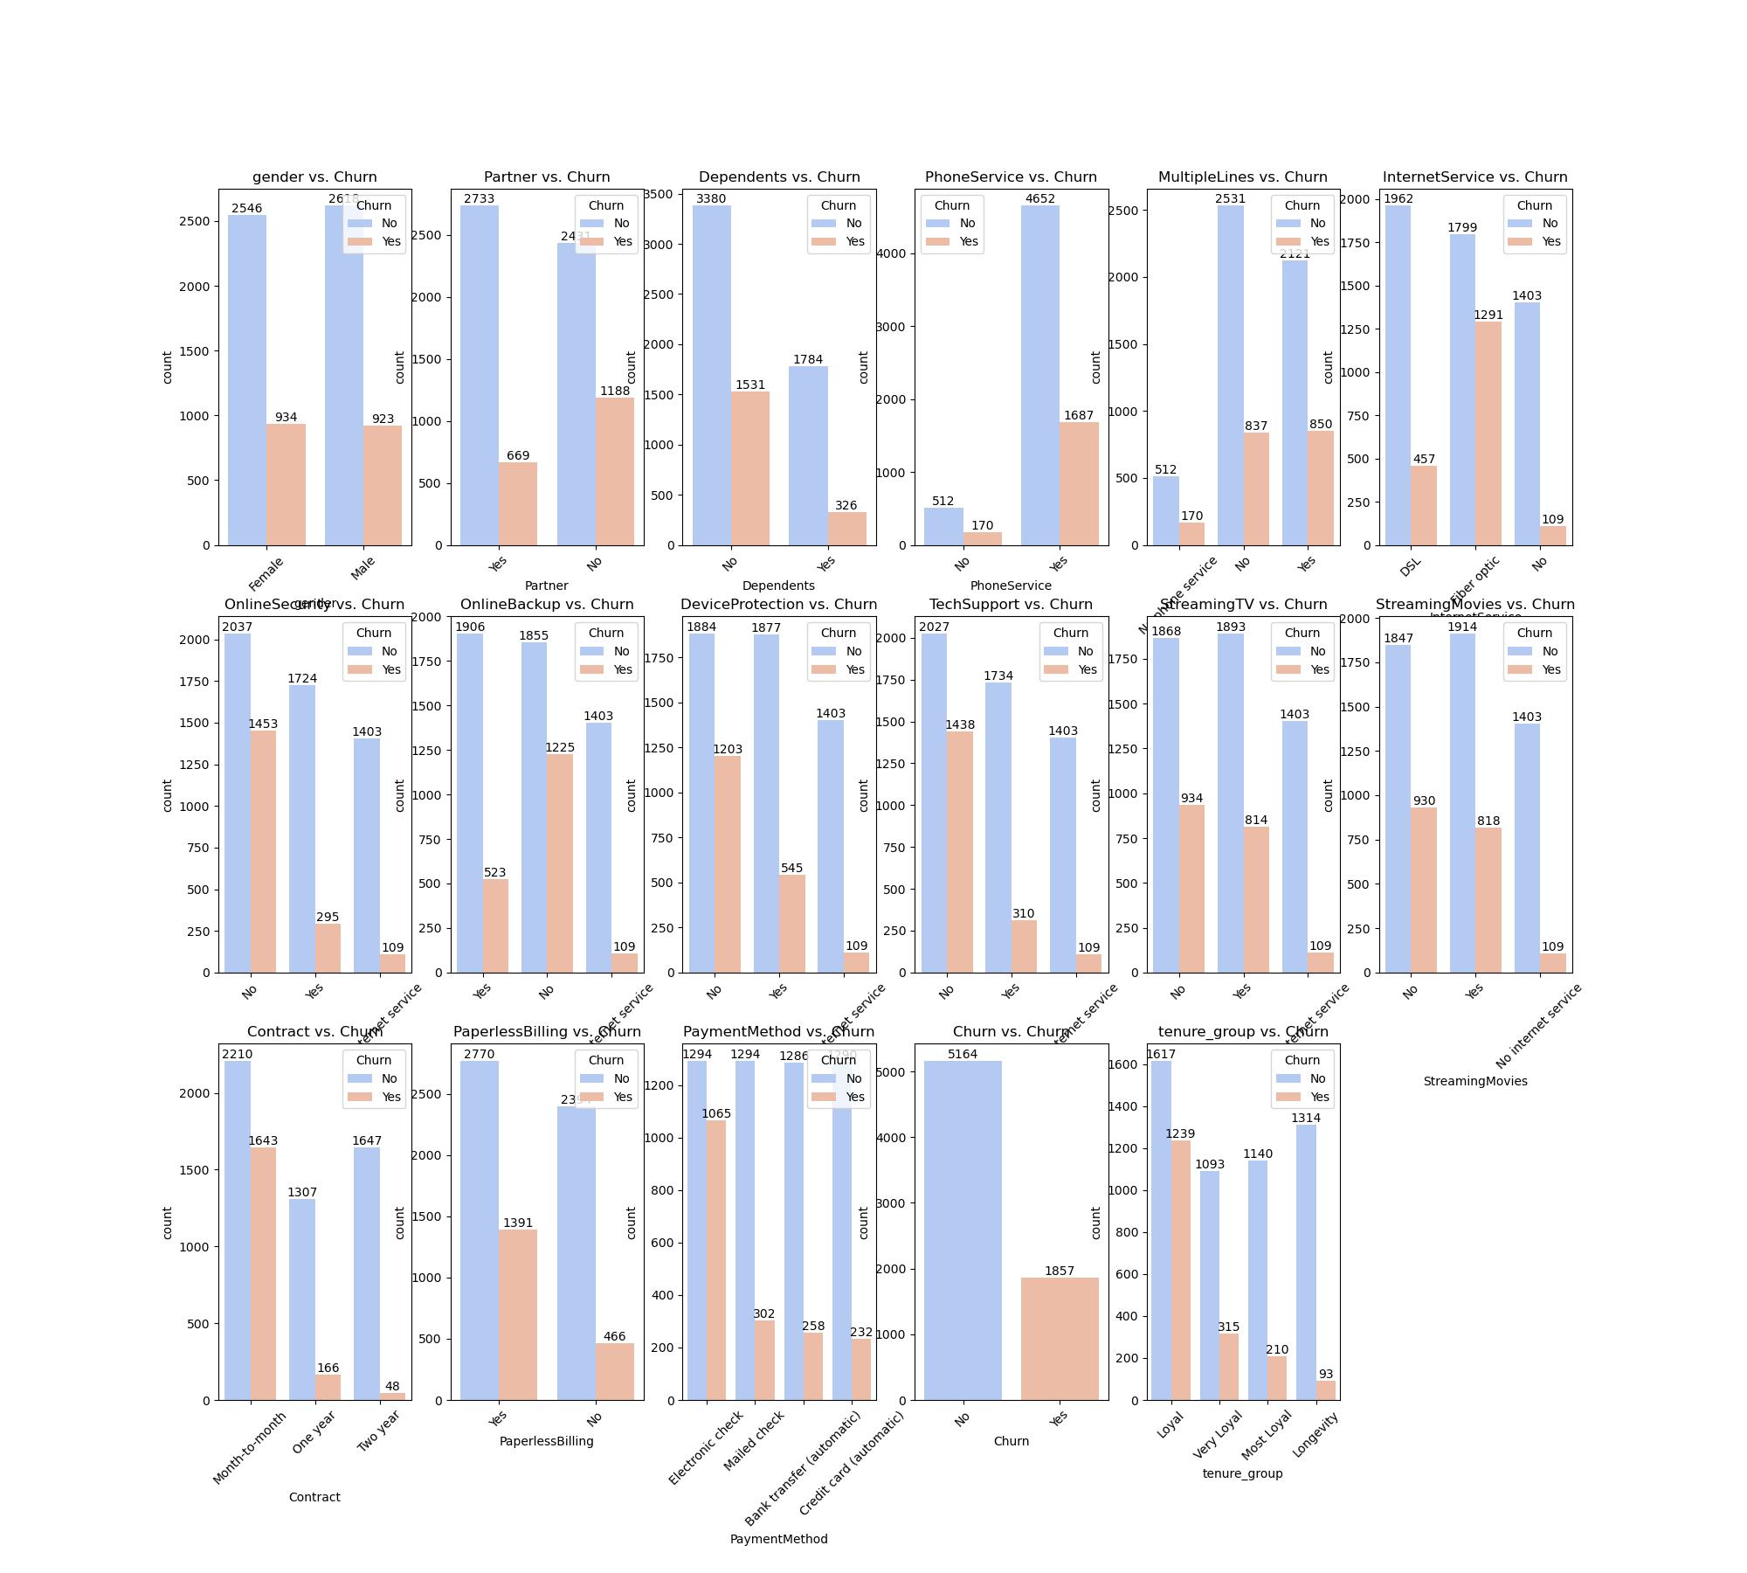
categorical features and churn
Key insights (EDA)

Slide 9
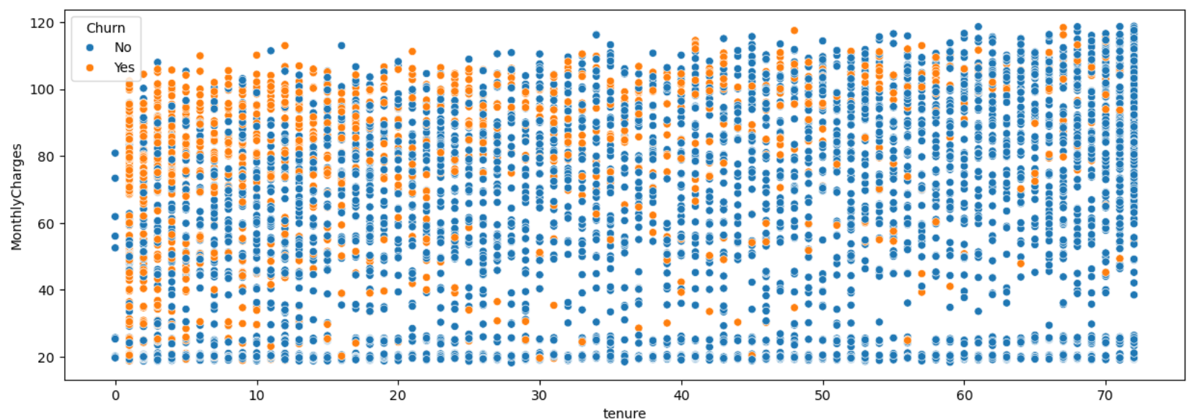
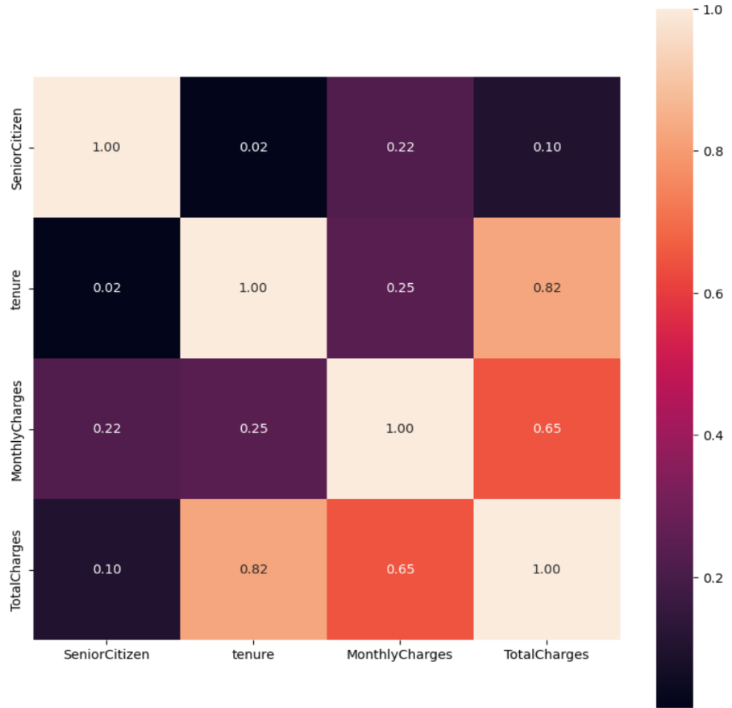
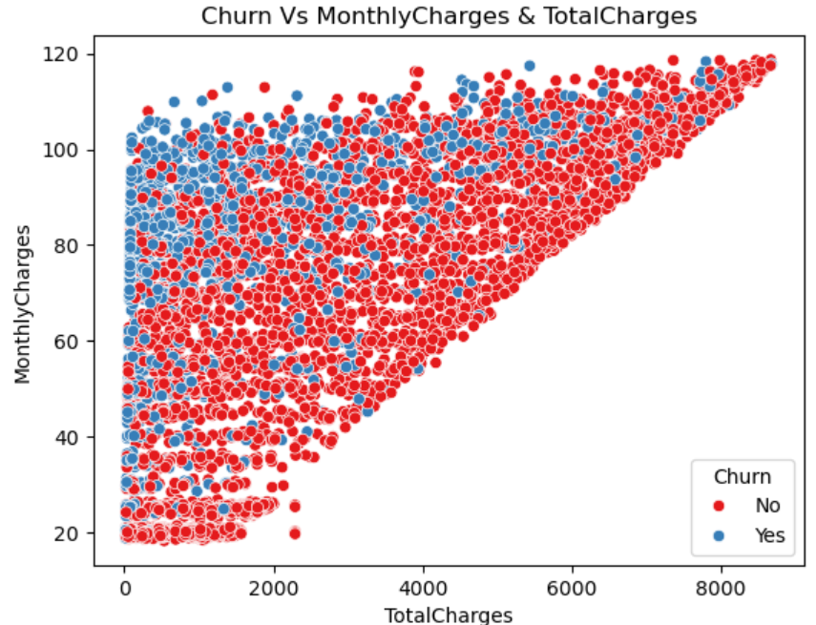
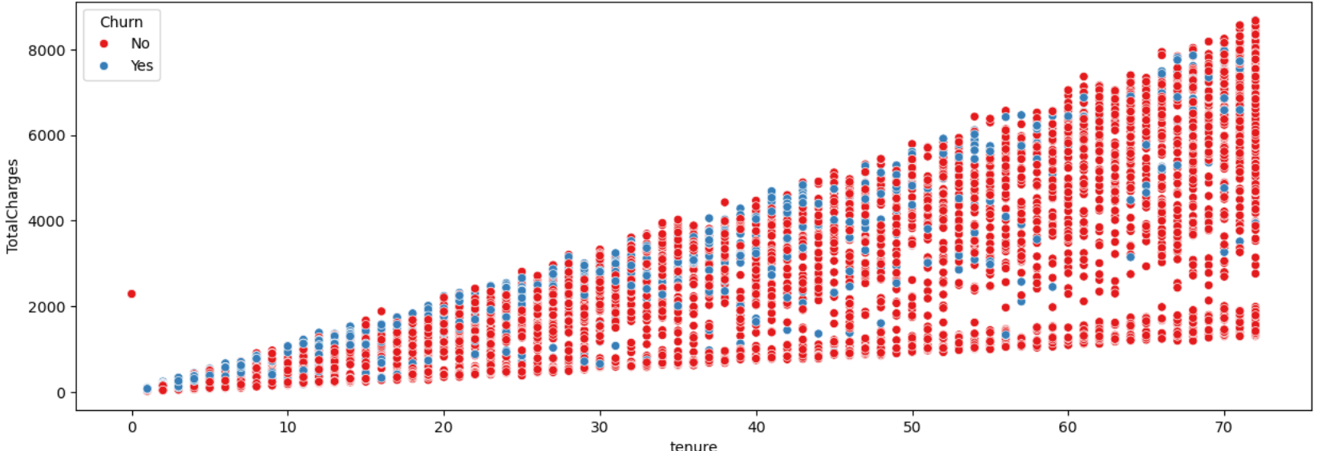
Key insights (EDA)
Numerical Features Analysis for trends
* Correlation between SalePrice and other variable in the dataset

Slide 10
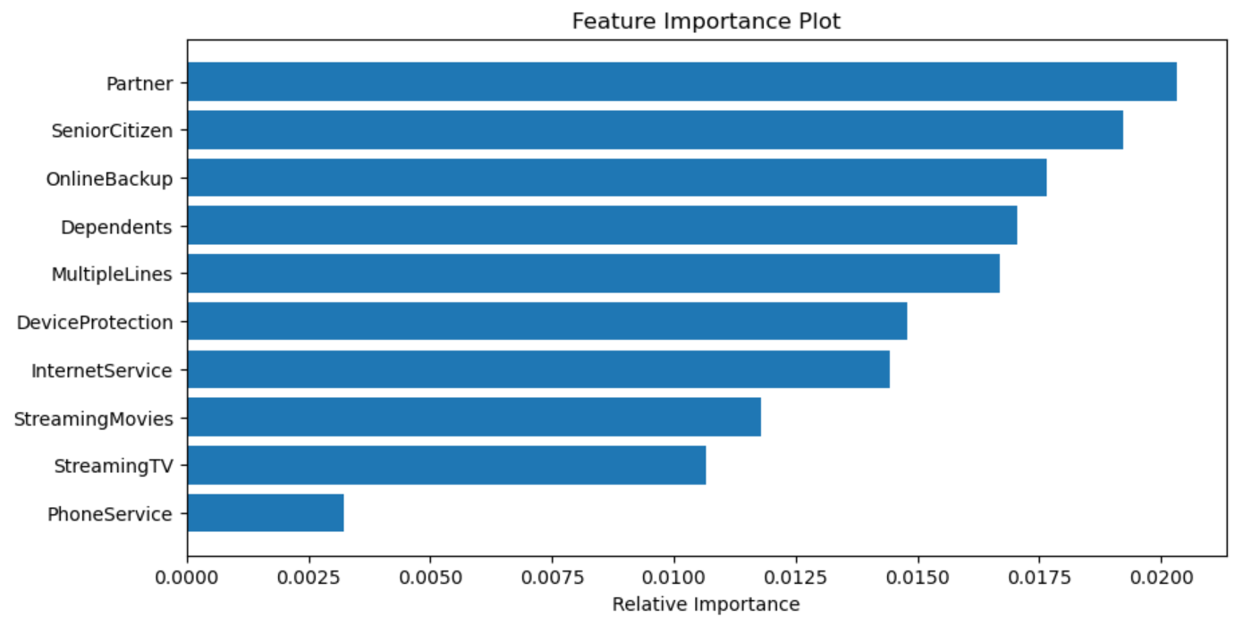
Feature Engineering
The above features ranked in the order of importance are the most relevant features in the dataframe which determines the outcome of the target variable. In this context, there determine whether a Connecttel subscriber will churn or not.
* Label Encoding - convert all categorical features in the dataset to numerical values.
Standardizing the features in the dataset – MinMaxScaler.

Slide 11
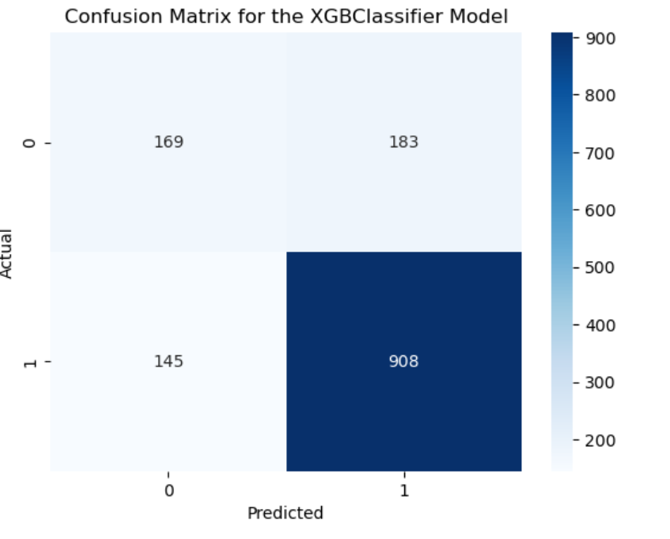
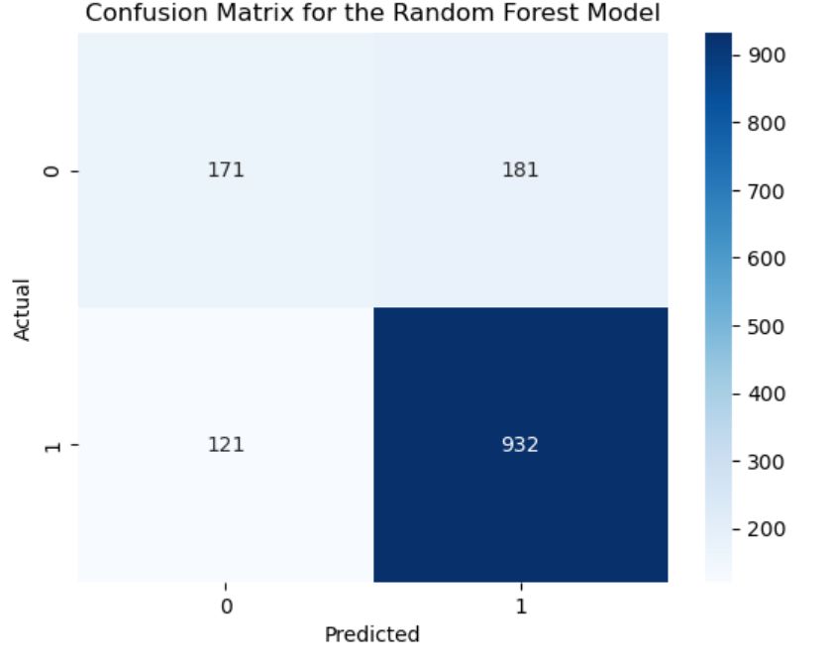
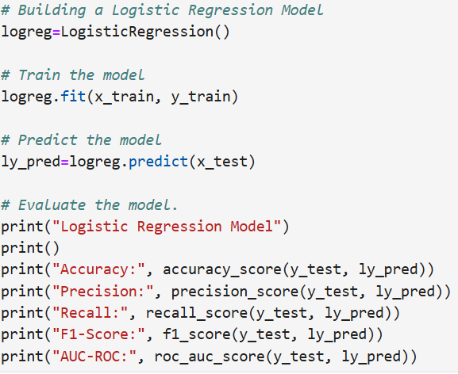
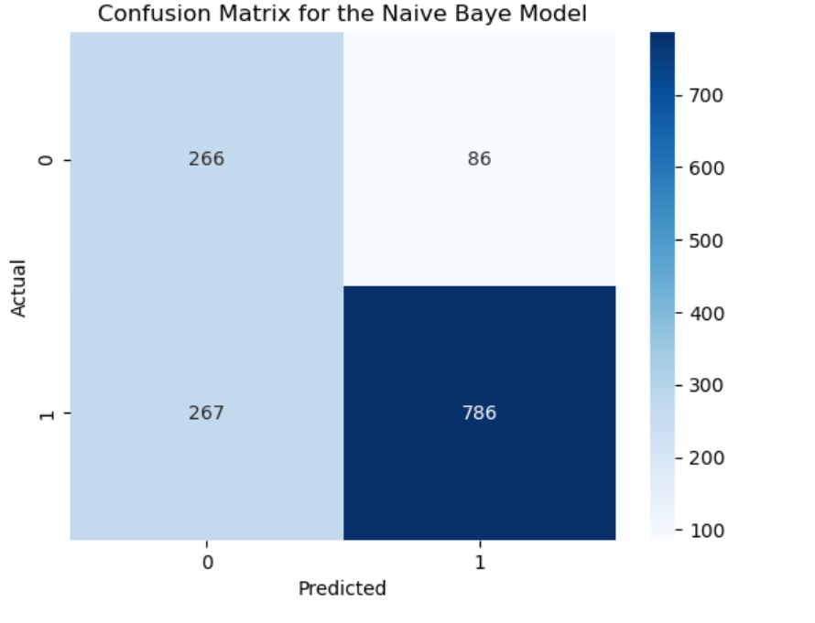
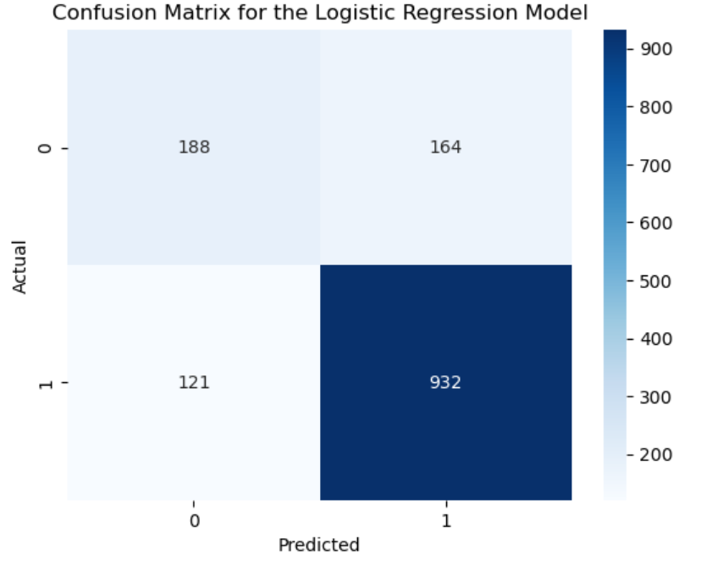
Feature Engineering
* Split the dataset into both training and test datasets. * Standardizing the features in the dataset – MinMaxScaler.

Slide 12
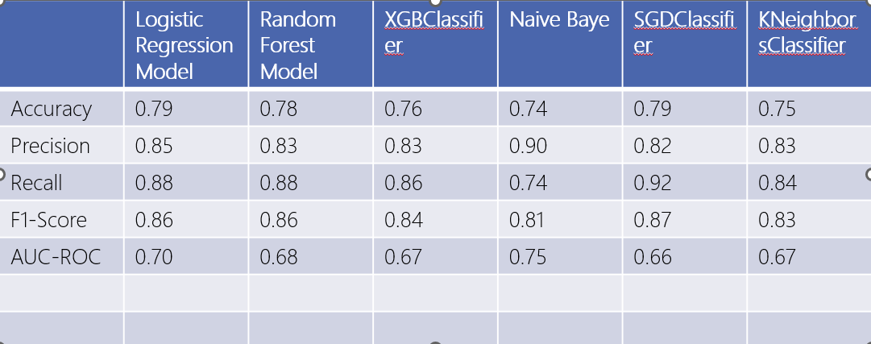
RESULT – Performance Model
Clearly the Logistic Regression Model achieved the best score with an accuracy score of 0.7968 (80%).

Slide 13
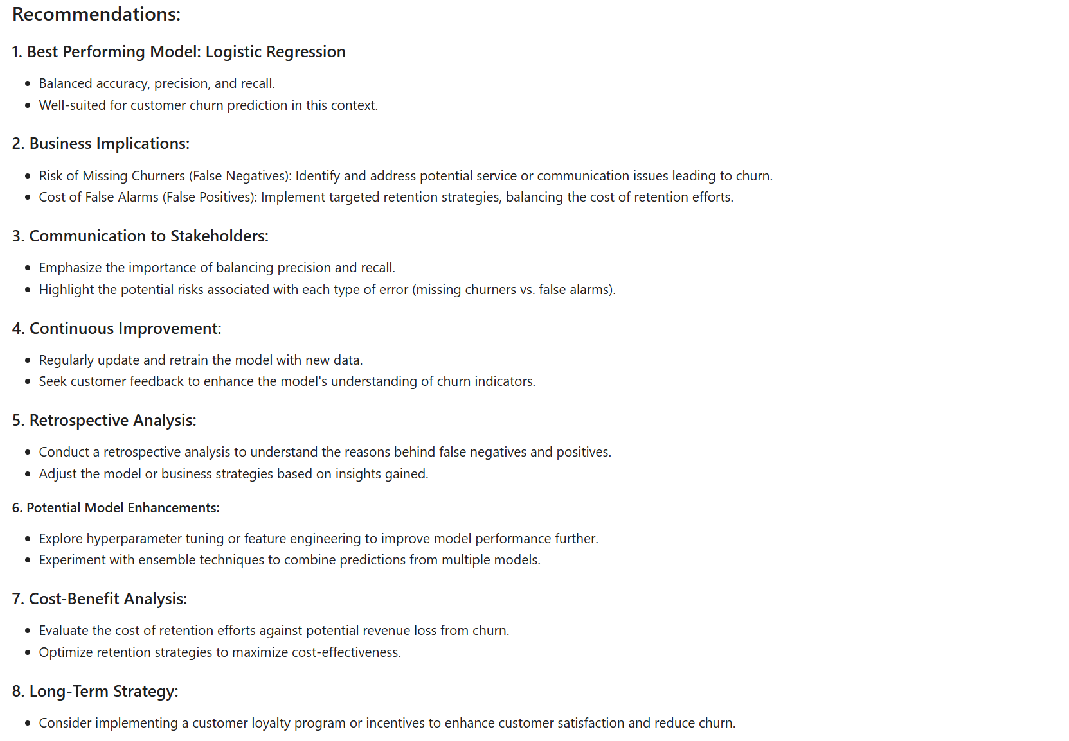

Slide 14

THANK YOU

